Slide 1

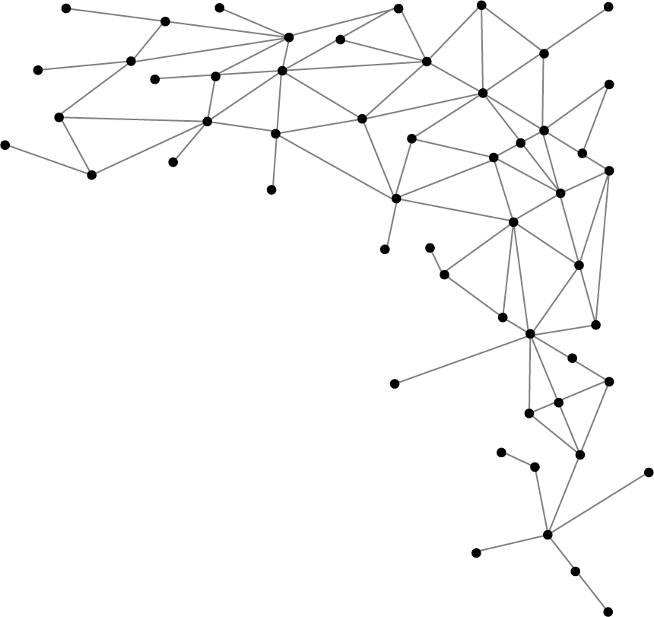
Link prediction
in Social Network

Slide 2

What is Link Prediction ?
Link prediction means to predict future interactions among new objects or removal of existing interaction by analyzing the features of present interactions. Link prediction has not only been confined to social network only also been an integral part of various fields such as sociology, biology and information system, basically those areas where their data can be graphically represented as network of interaction. Interaction is represented as graph of various nodes representing an individual and edges representing the relation between nodes.

Slide 3
Why we need Link Prediction ?
In actual world networks evolve in less than one second as new nodes and links are being adds to network in less than the blink of eye. In social network link prediction has played a vital role in recommendation of pages, shopping items and many more on the basis of user’s information, suggesting new connections on social media and in various fields such as in bioinformatics link prediction is used to predict interaction among proteins, in commerce link prediction is used to create a system that could recommend on the basis of user’s interest and in security link prediction is helpful to find hidden terrorist criminal gangs.

Slide 4
Our Objective
Aim is to have certain statically research on link prediction confined to only social network. This paper addresses and analyses the prediction accuracy of different algorithms. We expect that by our approach we would be able to find the accuracy of the algorithms along with we could also find that how the algorithms behave for different data. The aim of this paper is to review, analyze and discuss not all but some of the link prediction technique in social network. The end result of our research will be to compare the algorithms and find the best suitable algorithm and explain how networks evolve.

Slide 5
Different Link Prediction Methods
Link prediction techniques are based on various different features such as node information, topological behavior and social theory to calculate similarity score between a node pair. Learning based link prediction techniques are complex but they also depend on the resultant features of the metrics and external information. A descriptive classification of link prediction metrics and methods:
Node Based
Neighbor Based
Path Based
Random Walk Path

Slide 6
Neighbor Based Link Prediction Method
This method shows a similar trait as it is named. As human being a social animal tends to be in relation with person of their surrounding as neighbors are the closest one that interacts with a user. Therefore, metrics based on neighbor features has been most researched.
Neighbor based algorithms are Common Neighbor, Preferential Attachment, Jaccard Coefficient, Adamic Adar Index, Resource Allocation, Salton Cosine Similarity, Sorensen Similarity, Hub Promoted, Hub Depressed, Leicht Holme Nermen Index, Parameter Dependent, Community Index.

Slide 7
Common Neighbor
As the name suggest common neighbor, it works on the basis that two person having a common friend will introduce them. It simply predicts link by the measure of common neighbors two nodes have. This algorithm is comparable to any real world example.
CN (x, y) = | N (x) ∩ N (y) |

Slide 8
Preferential Attachment
This algorithm suggest that any social media user who have many friends or very social tends to connect with more friends. It can simply understand by an example that rich wants to get richer. It simply predicts link by the measure of number connecting node both the nodes have together or how high their degree are.
PA (x, y) = | N (x) | · | N (y) |

Slide 9
Jaccard Coefficient
This algorithm suggest that it doesn’t matter how much common friends both individual have rather how effective a particular feature here common neighbor can help to predict interaction between two friends. It doesn’t predict link simply measuring common neighbor rather it calculates for the possibility among the two nodes for connection.
JC (x, y) = | N (x) ∩ N (y) | / | N (x) U N (y) |

Slide 10
Adamic Adar Index
This algorithm states that if two individual share more common characteristic that is common friends is less likely to form link in future as compared to those who shares less common friends. It predicts algorithm by inversing the value of log of number of common neighbors.
AA (x, y) = z ϵ (x) ∩ (y) 1 / log | N (z) |

Slide 11
Resource Allocation
This algorithm state that if two individual are close to each other tend to have interaction as compared to them who are distant apart. It simply predicts link by simply measuring the closeness of two nodes.
RA (x, y) = z ϵ (x) ∩ (y) 1 / | N (z) |

Slide 12
Salton Cosine Similarity
This algorithm is based on theory of vectors it predicts link by creating a vector for each node pair and calculates the dot product of the common neighbor feature.
SC (x, y) = | N (x) ∩ N (y) | / root ( | N (x) | · | N (y) | )

Slide 13
Sorensen Index
This algorithm predicts link by comparing the similarity here common neighbor of two nodes.
SI (x, y) = | N (x) ∩ N (y) | / | N (x) | + | N (y) |

Slide 14
Hub Promoted Index
This algorithm predicts link on the basis of the property that links adjacent to hubs here nodes will have a higher similarity score.
HP (x, y) = | N (x) ∩ N (y) | / min ( | N (x) |, | N (y) | )

Slide 15
Hub Depressed Index
This algorithm predicts link completely on the basis of the property exactly opposite of the property of hub promoted that is links closer to hub that is nodes will have a lower similarity score.
HD (x, y) = | N (x) ∩ N (y) | / max ( |N (x) |, | N (y) | )

Slide 16
Leicht Holme Index
This algorithm is based on the theory that the two nodes will form a link if their neighbors in the network are also similar.
LHN (x, y) = | N (x) ∩ N (y) | / | N (x) | · | N (y) |

Slide 17
About Dataset
Focusing on different aspects and project requirement 5 different dataset has been downloaded from web Facebook, Facebook Food page, Facebook Sport page, Hamsterster from Network Repository and Vote from Snap.
Dataset | Nodes | Edges
Facebook | 1446 | 59589
FB_Food | 962 | 18812
FB_Sport | 1518 | 32988
Hamsterster | 2426 | 16631
Vote | 1005 | 25572

Slide 18
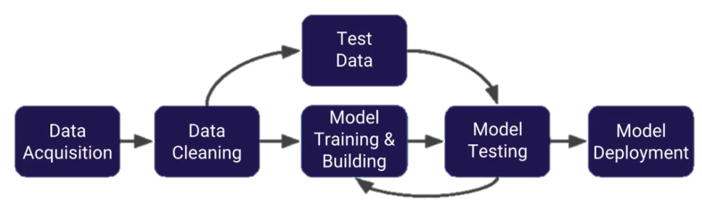
Use of Machine Learning
Machine learning help in comparing and analyzing the link prediction algorithms, and given they are combined with the right feature sets can produce good results. We used supervised machine learning algorithms to predict future connecting nodes with a good precision and accuracy in a given network.
Machine Learning Algorithm we used for link prediction are K Nearest Neighbor, Artificial Neural Network, Random Forest

Slide 19
Planning and Execution
Data Preparation
There are various categorizations, division and evaluation that needs to be done:
Extracting the connecting nodes from the edge list and converting it into data frame.
Creating a matrix of 0s and 1s and index representing nodes.
Selecting a subset of missing edges from the set of all missing edges.
Randomly omitting few edges from the downloaded dataset and adding it to the missing edges data.

Slide 20
Planning and Execution
Applying Neighbor Based Algorithms
Common Neighbor, Preferential Attachment, Jaccard Coefficient, Adamic Adar and Resource Allocation have predefined function to calculate value.
common_neighbors(G, n1, n2)
resource_allocation_index(G, [ebunch])
jaccard_coefficient(G, [ebunch])
adamic_adar_index(G, [ebunch])
preferential_attachment(G,[ebunch])

Slide 21
Planning and Execution
Applying Neighbor Based Algorithms
Salton Cosine Similarity, Sorensen Index, Hub Promoted Index, Hub Depressed Index and Leicht Holme Nerman do not have predefined functions but are dependent on the values of above functionalities.
salton_cosine=common_neighbor/sqrt(preferential_attachment)
sorensen_index=common_neighbour/num(node1+node2)
promoted_index=common_neighbour/min(node1,node2)
depressed_index=common_neighbour/max(node1,node2)
lhn_index=common_neighbour/preferential_attachment

Slide 22
Planning and Execution
Applying Machine Learning Algorithms
Two variables X of data frame type containing the values of features that are two nodes and that particular feature for which the value will be calculated and y of data frame type containing the values of field ‘Link’. Data is then divided into test and train dataset. Train dataset have 75% of total data and test will have 25% of data.
The training data is been fitted in the algorithm and at last the model is deployed on the test data except for K- NN where before fitting the data the data requires preprocessing, the data is been first converted to a scalar format. Then at last the result is been transformed in the form of Confusion matrix, Classification Report, Roc Auc Score and Roc curve is printed and plotted.

Slide 23
Contribution
Common Neighbor, Preferential Attachment, Jaccard Coefficient, Adamic Adar Index and Resource Allocation were main research focus of Samar Sharma.
Salton Cosine Similarity, Sorensen similarity, Hub Promoted Index, Hub Depressed Index and Leicht Holme Index were main research focus of Piyush Kumar Roy.

Slide 24
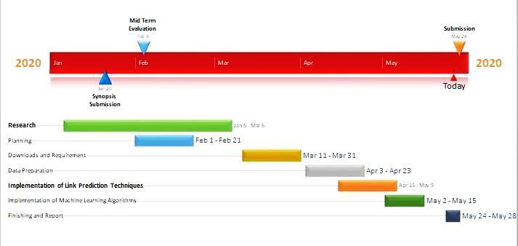
Gant Chart

Slide 25
Conclusion
This paper was majorly focused on the review of Neighbor based metrics and to correlate the behavior of these algorithms on different network and along with evaluating how network grow with time. Link prediction problem and applications are also been referred in the paper. At the end previous researches done by scholars, our future directions and challenges we faced are also been addressed. In the end we conclude that this research paper is a small step towards the direction of learning and exploring new methods and theory to improve link prediction and resolving the present issues that still needs to be resolved.

Slide 26
Future Improvement
We used random deletion of edges in order to analyze the growth of network. But in in the real world no network grows by random addition of links rather follows preferential attachment model. In order to draw any conclusion the method we use should be comparable to real world scenario by analyzing network growth data by time stamp.

Slide 27
Future Improvement
Further adding more algorithms of different feature dependency, after analyzing all the algorithms and comparing algorithms and generalizing our work we can try creating a new improved algorithm that will be more sustainable.

Slide 28
Future Improvement
Further evaluating the algorithms and analyzing the relation of algorithms with the network and to study why algorithms behave differently for different networks we require more numbers of diverse network and hardware system much more feasible to handle large data. Because of limited computational power of system available at present time and many such limitations we cannot evaluate further but this can be carried further after fulfilling the requirement.

Slide 29

Thank You
Group Members:
Piyush Kumar Roy 179301142
Samar Sharma 179302126

